Slide 1
Experimental Evaluation of Matter Multi-Admin Scalability and Interoperability on ESP32
John E. Esquiagola Aranda · Jorge A. Flores Morón · Ricardo B. Uribe Bejarano
Microelectronics Group — Dept. of Engineering, Pontificia Universidad Católica del Perú (PUCP)

Slide 2
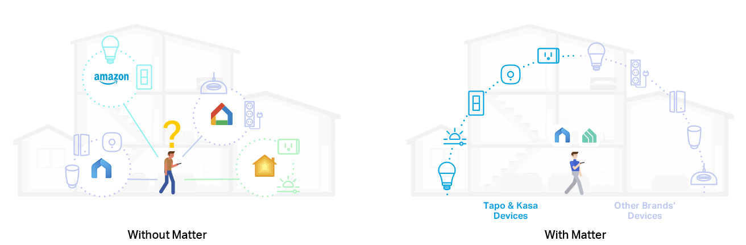
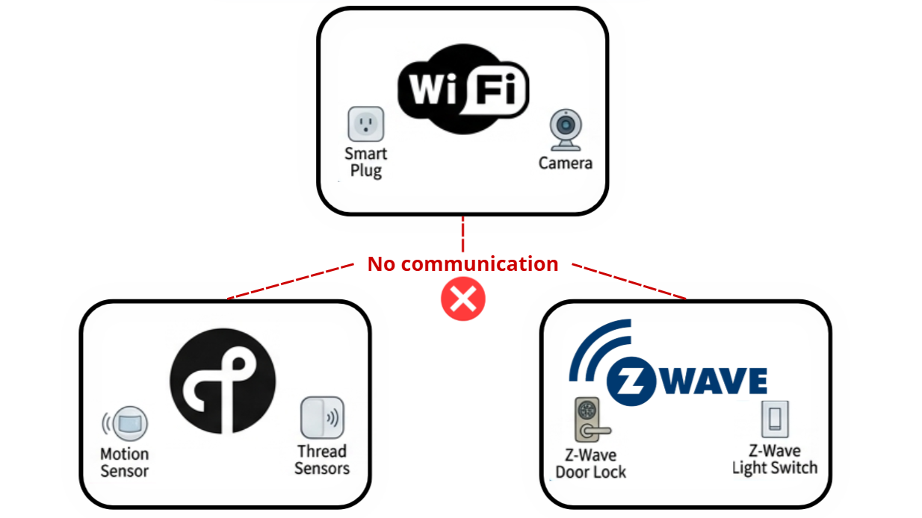
Introduction – The interoperability challenge:
Fragmentation and lack of interoperability among IoT ecosystems, such as smart homes, industrial automation, and intelligent buildings.
Non-interoperable communication protocols.
Proprietary platforms and vendor-dependent solutions.
Fragmented IoT Smart home ecosystem [1]
Non-interoperable communication protocols

Slide 3
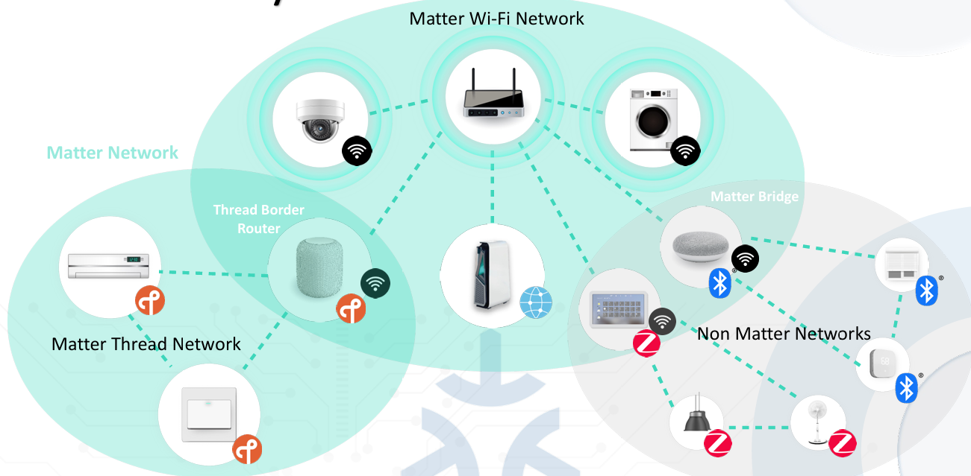
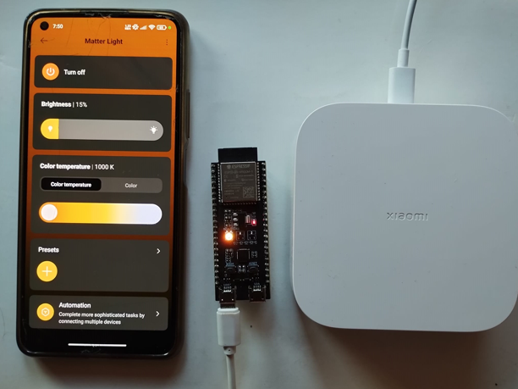
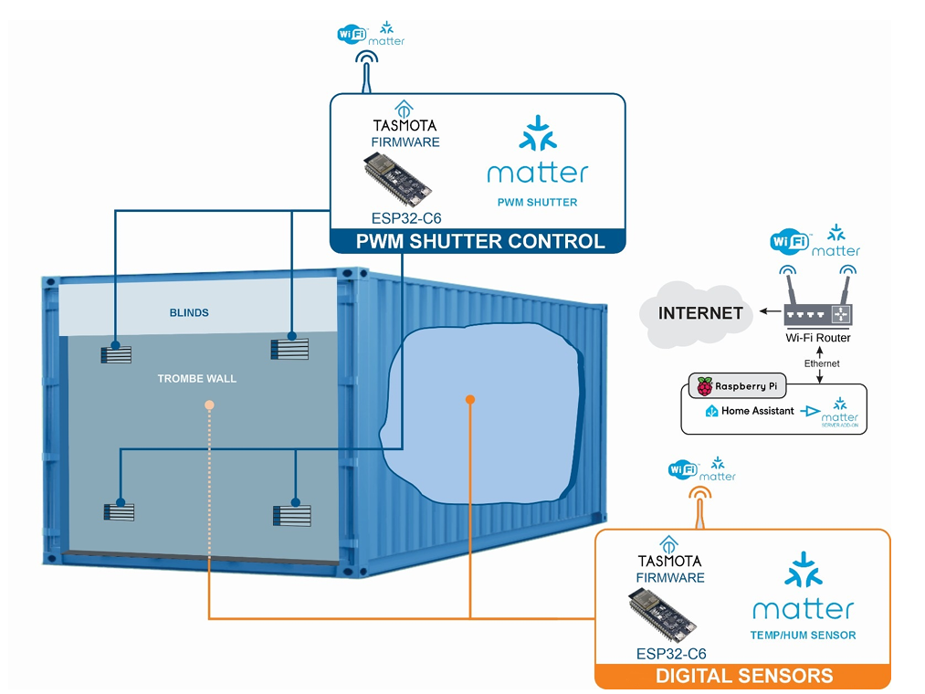
State of the art:
Matter Standard: Unified IP-based application-layer standard that enables interoperability across heterogeneous ecosystems.
Multi-Admin Research Gap: Lack of empirical studies evaluating ESP32 nodes operating simultaneously across multiple fabrics (ecosystems).
Embedded Resource Impact: Existing studies lack quantitative evaluation of performance parameters of ESP32 nodes under Matter operation.
Matter based Smart home ecosystem [2]
Matter protocol integration using ESP32 [3]
Trombe wall automation and control [4]

Slide 4
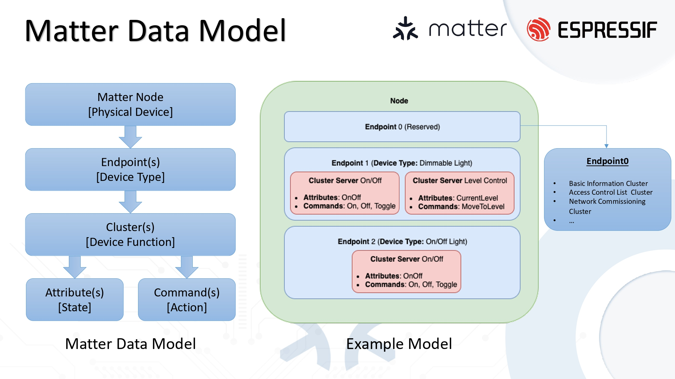
Matter protocol – Overview:
A. Matter Protocol Architecture
Hierarchical Data Model: Nodes → Endpoints → Clusters.
Standardized Functionality: Clusters define interoperable attributes, commands, and events.
Application Structure: Endpoints organize device functionalities through standardized clusters.
B. Operational Identity & Security Model
Fabric-Based Identity: Each fabric represents an independent administrative trust domain.
Multi-Fabric Operation: Devices maintain independent Node IDs and operational credentials for each fabric.
Device Authentication: Device Attestation Certificate (DAC) and Product Attestation Authority (PAA) certificates establish device authenticity during commissioning, with the Distributed Compliance Ledger (DCL) supporting certification verification.
C. Secure Sessions: PASE & CASE
PASE (Passcode Authenticated Session Establishment): Used during commissioning to establish a secure session between the commissioner and the device using the device setup passcode.
CASE (Certificate Authenticated Session Establishment): Used for operational communication, providing mutual authentication through Node Operational Certificates (NOCs).
Secure Communication: Fresh session keys protect application-layer exchanges between authenticated Matter nodes.
Matter hierarchical data model [5]

Slide 5
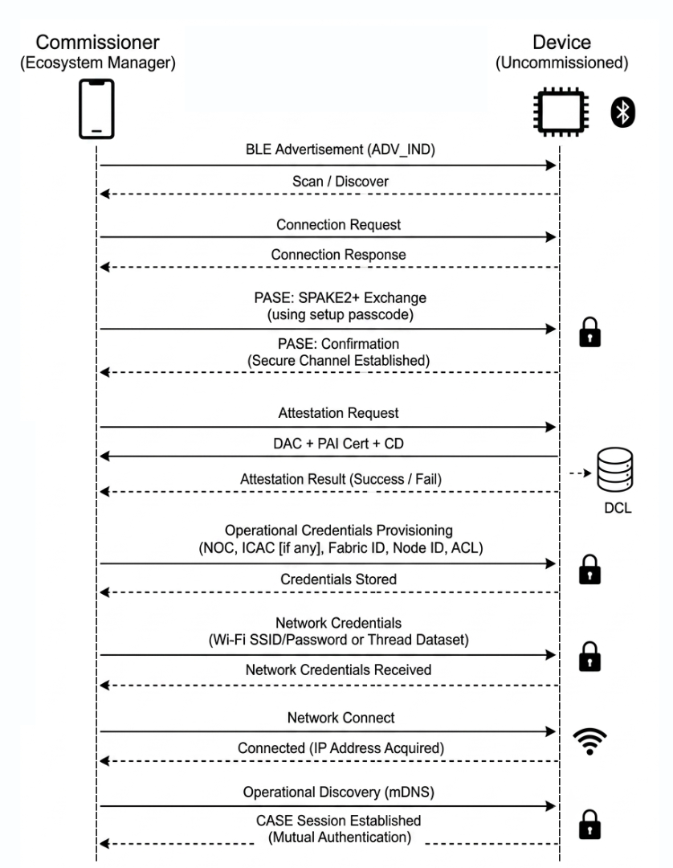
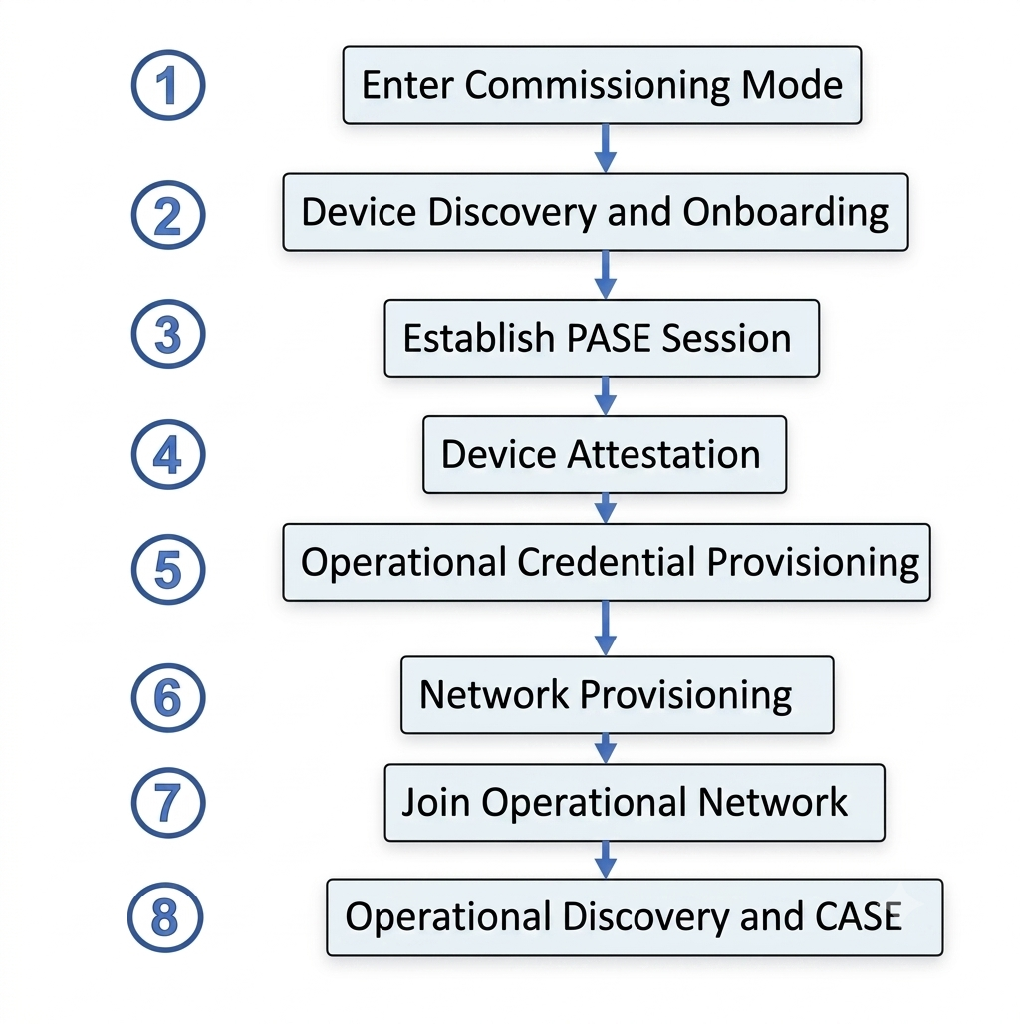
Matter protocol – Commissioning:
1
2
3
4
5
6
7
8
Matter Commissioning Flow
Commissioning Stages

Slide 6
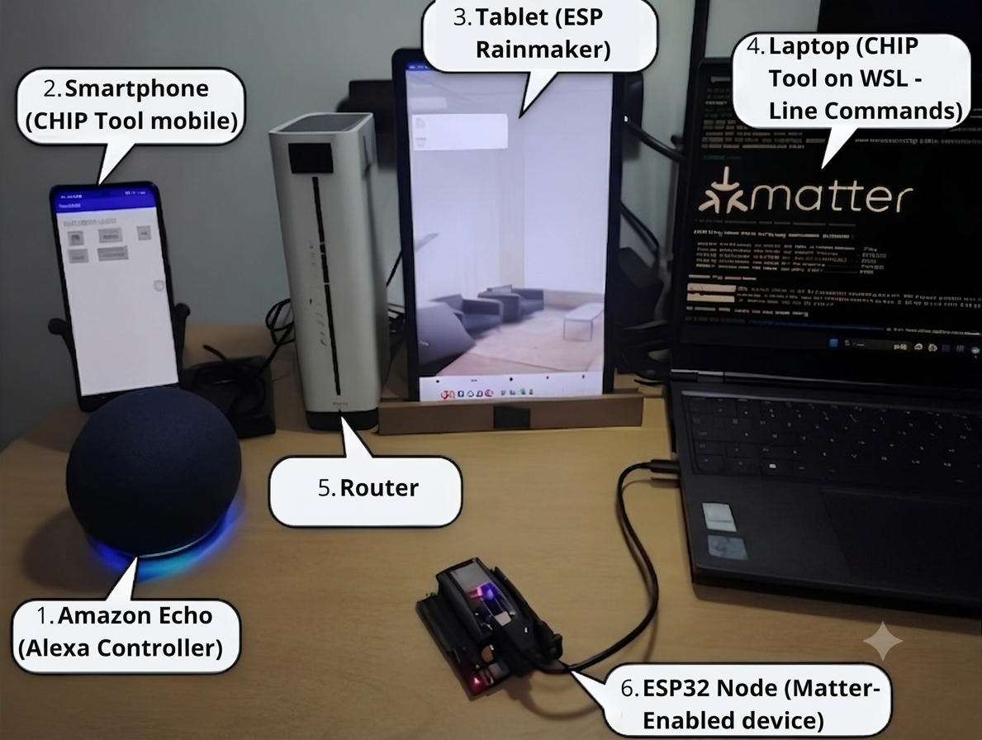
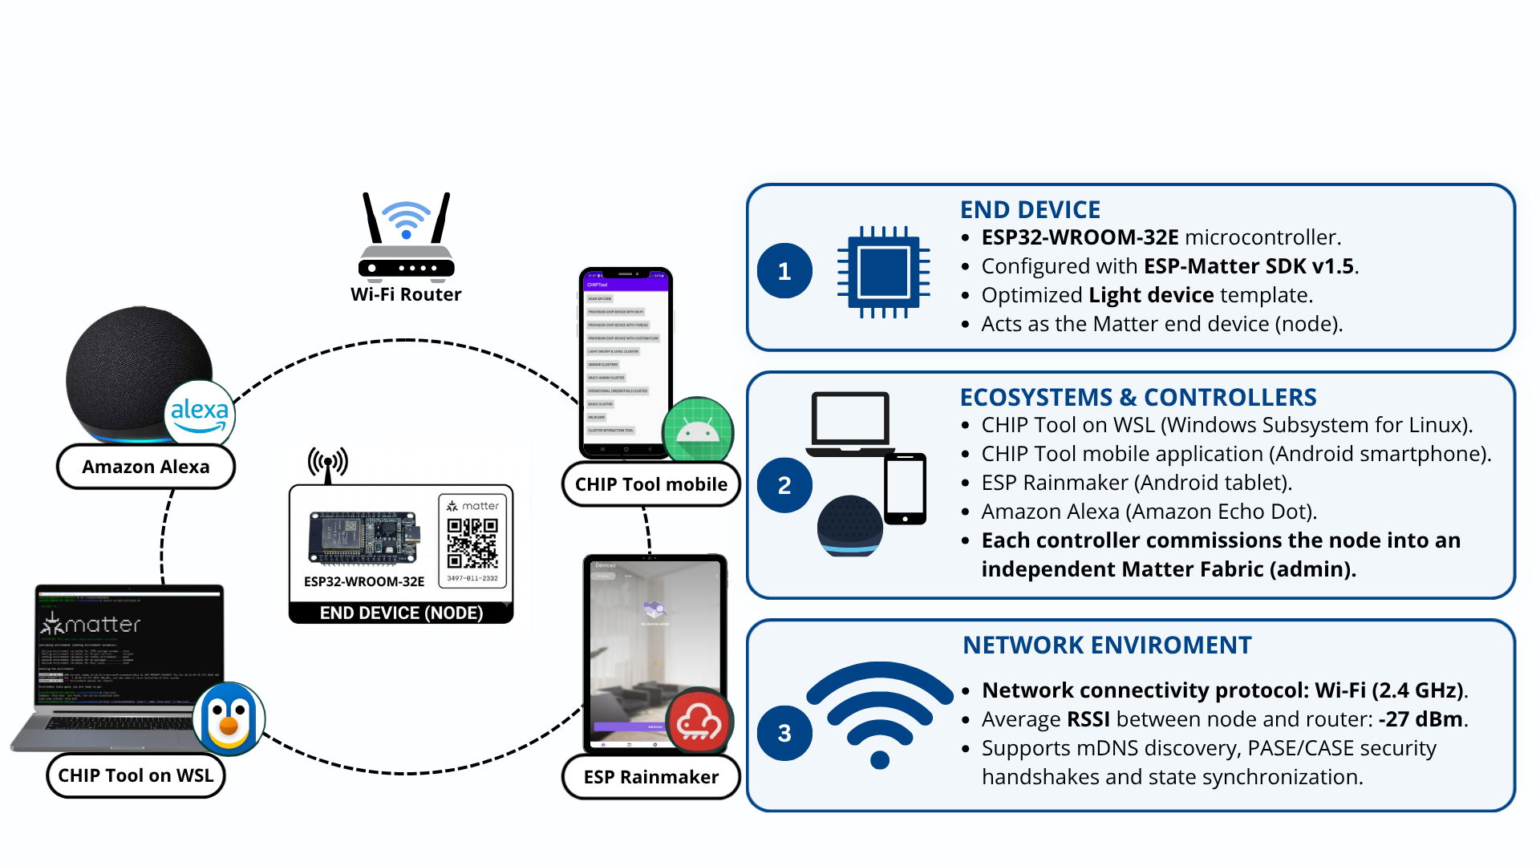
System architecture and implementation:
Objective: Evaluate Matter multi-admin operation across heterogeneous fabrics (ecosystems) and measure its scalability and interoperability.
Experimental setup used for evaluation
Multi-admin architecture

Slide 7
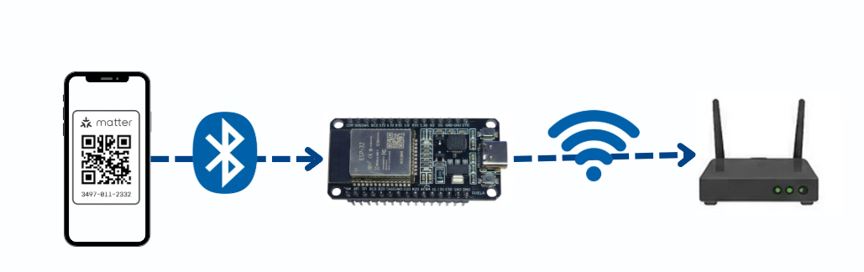
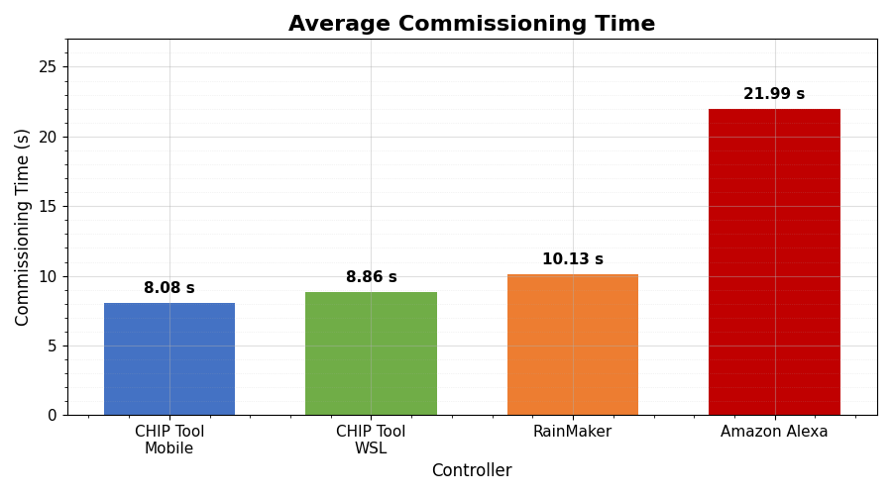
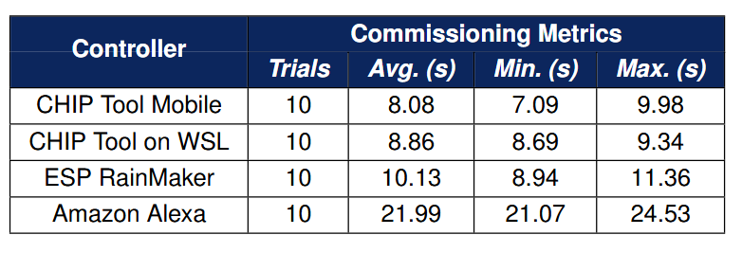
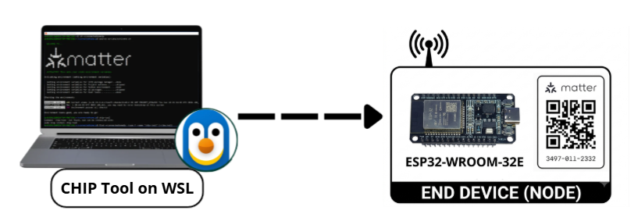
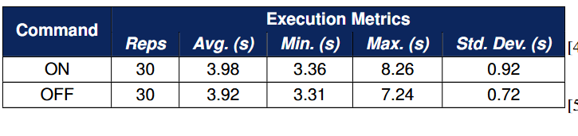
Performance evaluation and results:
1. Commissioning Time:
Fastest Onboarding: CHIP Tool achieved the lowest commissioning time, averaging between 8.08 s and 8.86 s.
Commercial Overhead: Amazon Alexa recorded the highest commissioning time due to manual user confirmations and additional validation steps to ensure that only authorized devices are added to the ecosystem.
2. Command Execution and Reliability:
100% Reliability: Achieved zero packet loss and a 100% success rate across 60 execution trials under normal local Wi-Fi conditions.
Consistent Latency: Application-level RTT remained stable at ~3.9 s for both ON (3.98 s) and OFF (3.92 s) commands.
Low Execution Jitter: Standard deviation stayed below 0.92 s, demonstrating robust local synchronization without retransmissions.

Slide 8

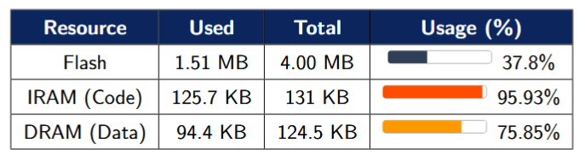
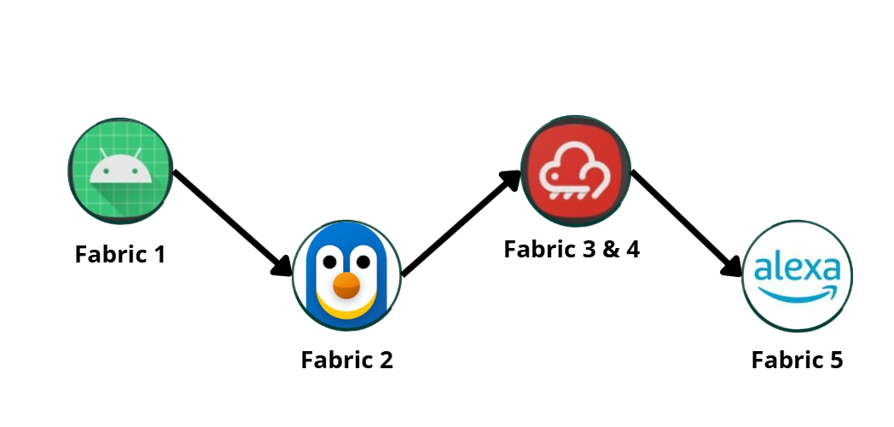
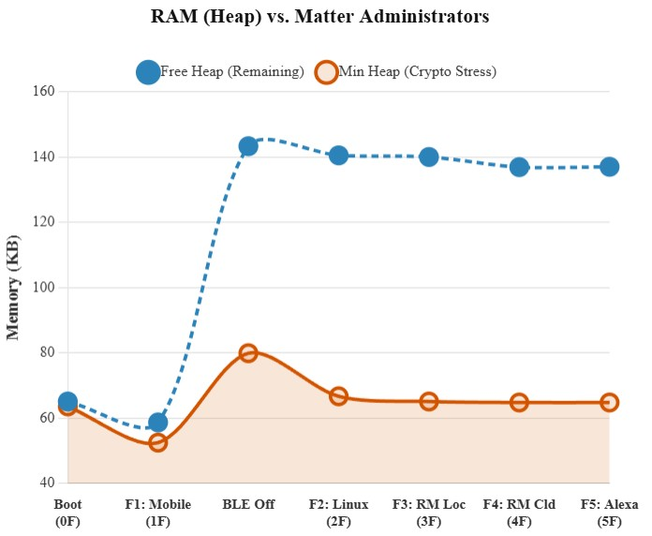
Performance evaluation and results:
3. Static Memory Footprint:
Flash Headroom: Compiled firmware occupies 37.8% of Flash capacity), leaving ample room for application code and OTA updates.
RAM Utilization: Heavy static load on internal IRAM (95.93%) and DRAM (75.85%) driven by Matter protocol and FreeRTOS stacks.
Operational Boundary: Demonstrates full protocol feasibility on the ESP32 while highlighting operation near internal memory limits.
4. Dynamic Memory Footprint During Fabric Addition:
Initial BLE Bottleneck: Cryptographic stress (SPAKE2+ handshake over BLE) during initial onboarding causes a temporary drop in minimum free heap.
Post-Commissioning Recovery: De-initializing BLE post-pairing restores free heap to ~143 KB, providing a stable operational buffer.
Multi-Admin Scalability: IP-based fabric additions are highly efficient (~1.5 KB to 3 KB per fabric), successfully sustaining 5 concurrent fabrics without memory exhaustion.

Slide 9
Conclusions and future work:
Conclusions:
Future work:
Reliable multi-ecosystem operation: The ESP32 functions as a stable IoT node across independent Matter fabrics simultaneously.
Consistent commissioning and state synchronization without proprietary cloud bridges.
Commissioning time varies by controller, driven by cloud dependencies and extra confirmation steps for uncertified devices (Alexa).
100% command execution reliability (ON/OFF) under strong network conditions.
Efficient multi-admin memory scaling: BLE onboarding causes the main heap drop; each added fabric overhead costs only ~1.5–3 KB.
Up to 5 simultaneous fabrics supported with no risk of memory exhaustion.
Evaluate performance under critical network conditions.
Analyze power consumption and thermal behavior of the ESP32 Matter node.
Assess whether cryptographic load and high memory usage cause overheating or instability in long-term multi-admin operation.
Explore additional transport-layer protocols: Thread, Zigbee, Z-Wave.
Test more complex device types from the ESP-Matter SDK.
Optimize firmware to reduce static memory footprint.
Build a centralized Matter Dashboard Hub with Home Assistant for cross-fabric latency tracking and automation orchestration.

Slide 10
References:
[1] TP-Link, “Matter,” TP-Link Uruguay. [Online]. Available: https://www.tp-link.com/uy/technology/matter/
[2] Espressif Systems, “Introduction to Matter,” Webinar slides, 2022, accessed: Dec. 7, 2025. [Online]. Available: https://www.espressif.com/sites/default/files/pdf/Webinar_1_Intro_to_Matter.pdf
[3] A. Mota, C. Serodio, and A. Valente, “Matter Protocol Integration Using Espressif’s Solutions to Achieve Smart Home Interoperability,” Electronics, vol. 13, no. 11, p. 2217, Jun. 2024. [Online]. Available: https://www.mdpi.com/2079-9292/13/11/2217
[4] G. Conceição, T. Coelho, A. Mota, A. Briga-Sá, and A. Valente, “Smart Matter-Enabled Air Vents for Trombe Wall Automation and Control,” Electronics, vol. 14, p. 3741, 2025.
[5] Espressif Systems, “Introduction to Matter,” Webinar slides, 2022, accessed: Dec. 7, 2025. [Online]. Available: https://www.espressif.com/sites/default/files/pdf/Webinar_1_Intro_to_Matter.pdf
[6] I. Alam, B. T. Dang, and S. Pervez, “Innovative IoT Solutions: A Comprehensive Study of the MATTER Standard in Smart Home Integration,” in 2024 IEEE 9th International Conference on Engineering Technologies and Applied Sciences (ICETAS). Bahrain, Bahrain: IEEE, Nov. 2024, pp. 1–6. [Online]. Available: https://ieeexplore.ieee.org/document/11119901/
[7] Amazon Web Services, “Introduction to the Matter Standard,” AWS Prescriptive Guidance, 2023. [Online]. Available: https://docs.aws.amazon.com/prescriptive-guidance/latest/strategy-matter-standard/introduction.html
[8] Connectivity Standards Alliance, “Matter: The Foundation for Connected Things,” Connectivity Standards Alliance, 2023. [Online]. Available: https://csa-iot.org/all-solutions/matter/
[9] S. Madadi-Barough, W. Korani, P. Zhang, and F. Samie, “Matter: IoT Interoperability for Smart Homes,” arXiv preprint arXiv:2405.01618, 2024. [Online]. Available: https://arxiv.org/abs/2405.01618
[10] Espressif Systems, “ESP-Matter Documentation (ESP32),” Espressif, 2024, accessed: Nov. 13, 2025. [Online]. Available: https://docs.espressif.com/projects/esp-matter/en/latest/esp32/esp-matter-en-master-esp32.pdf
[11] Espressif Systems, “ESP-Matter SDK Documentation for ESP32,” 2025, accessed: Dec. 7, 2025. [Online]. Available: https://docs.espressif.com/projects/esp-matter/en/latest/esp32/
[12] K. Sovani, “Matter: Clusters, Attributes, Commands,” Espressif Developer Portal, Nov. 2021, accessed: Dec. 7, 2025. [Online]. Available: https://developer.espressif.com/blog/matter-clusters-attributes-commands/
[13] Keyfactor, “Create CAs for Matter Operational PKI,” Keyfactor Docs, 2023, accessed: Dec. 7, 2025. [Online]. Available: https://docs.keyfactor.com/ejbca/latest/create-cas-for-matter-operational-pki
[14] Schutzwerk GmbH, “Security Considerations for Matter Developers,” Schutzwerk GmbH, 2023, accessed: Dec. 7, 2025. [Online]. Available: https://www.schutzwerk.com/en/blog/matter-security-considerations
[15] Silicon Labs, “Matter Security Fundamentals,” Matter Fundamentals, 2025, accessed: Dec. 7, 2025. [Online]. Available: https://docs.silabs.com/matter/latest/matter-fundamentals-security
[16] Espressif Systems, “Espressif Matter Solutions – ESP-Matter Programming Guide,” Espressif Systems, 2024, accessed: Jun. 26, 2026. [Online]. Available: https://docs.espressif.com/projects/esp-matter/en/latest/esp32/introduction.html#espressif-matter-solutions

Slide 11
Thank you very much for your attention
John E. Esquiagola Aranda
john.esquiagola@pucp.edu.pe
Jorge A. Flores Morón
a20200795@pucp.edu.pe
Ricardo B. Uribe Bejarano
r.uribe@pucp.edu.pe

